Slide 1

Astronomy and Python
Using coding activities to teach astronomy
Dimitrios Theodorakis
https://forms.gle/C1hXshdmpwuZkMQB9
Notes:
https://forms.gle/C1hXshdmpwuZkMQB9

Slide 2
Dimitrios
Teacher in the UK (RQT)
- General Science (Physics Specialism)
- Astronomy Module for BTEC Applied Science
@AstroDimitrios astrodimitrios.github.io
https://www.youtube.com/channel/UCf8Sg-cgLNubyCM5Em8eDZg/ https://github.com/astroDimitrios/Astronomy
astrodimitrios@gmail.com

Slide 3
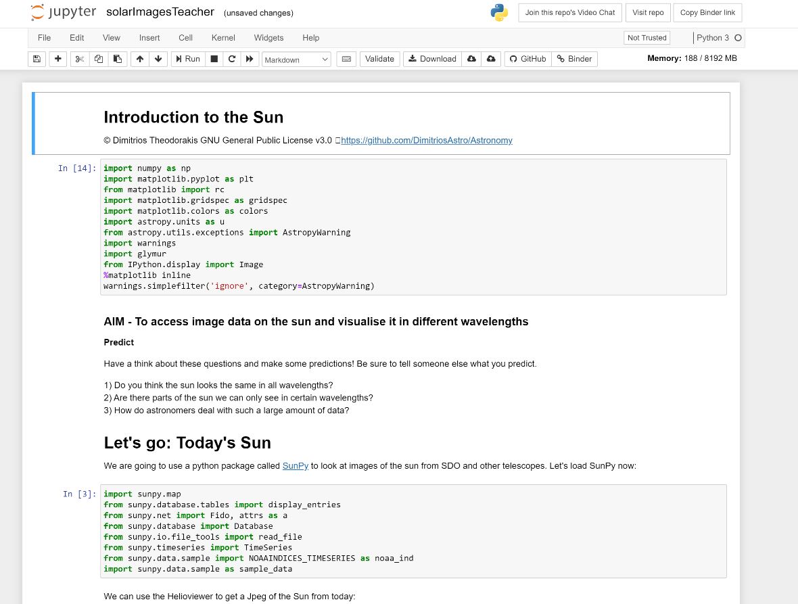
Teaching with Notebooks
Online – suitable for virtual learning
Free – open source software and activities
Integrates a new skill into students learning
Provides interactivity where no standard physical activity exists
Brings astronomical data into the classroom
Notes:
The goal of the coding activities is mainly to process and visualise data and extract physical insights from them (as described in the AAPT report below).
https://www.aapt.org/Resources/upload/AAPT_UCTF_CompPhysReport_final_B.pdf

Slide 4
The Jupyter Notebook
Jupyter – Interactive data science online and in many languages
My notebooks are in Python 3 – widely used by astronomers
Support for the Markdown markup language, LaTeX, and Html.
Can be run free online: https://jupyter.org/try
Or through Google with Colab or Microsoft with Codespaces
Docs:
https://jupyter-notebook.readthedocs.io/en/stable/notebook.html

Slide 5
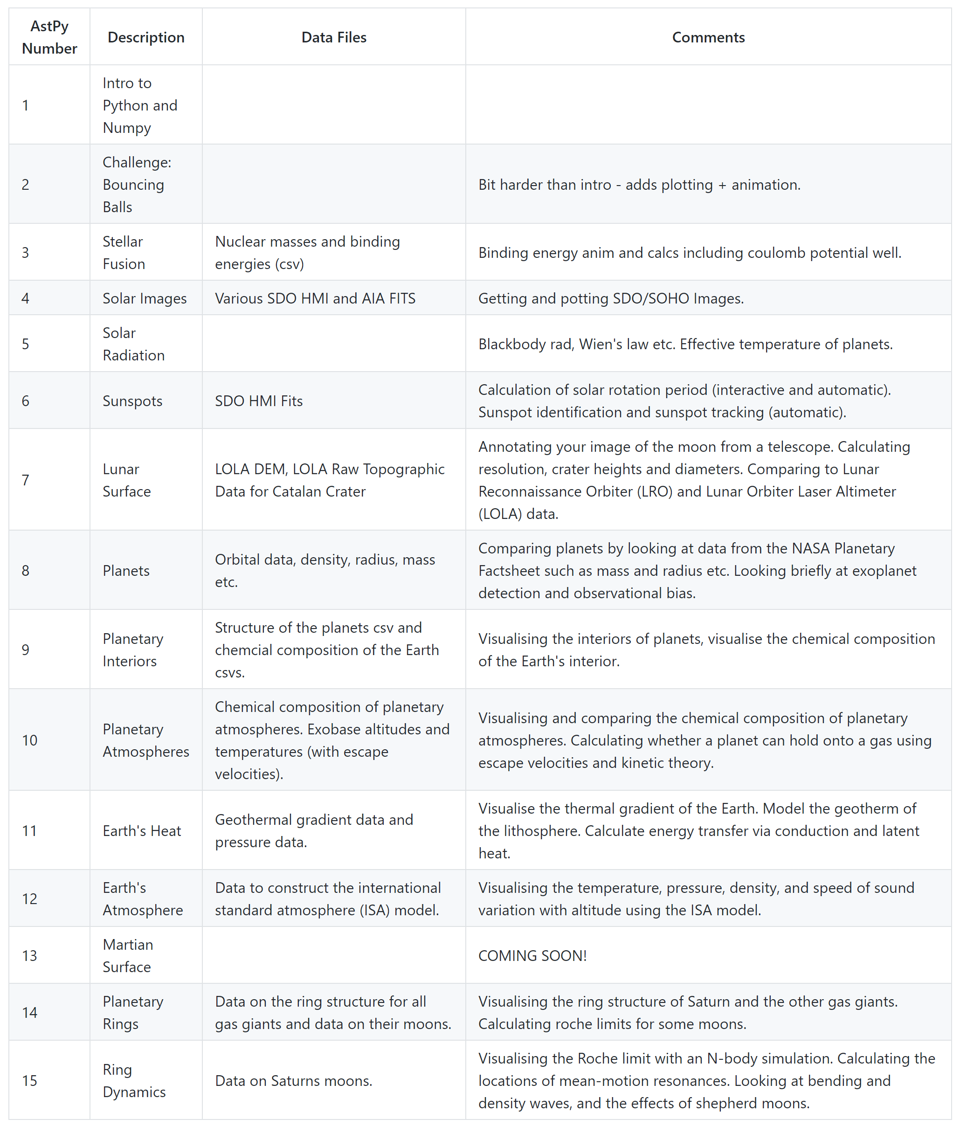
My
Notebooks
2 intro activities (1&2)
12 main activities
Some focus solely on visualisation and others just maths – most are a mix. Teacher version includes answers.
1.5 – 2 hours each
(+2 coding challenges)
Can all be seen in Binder:
https://mybinder.org/v2/gh/DimitriosAstro/Astronomy/master?filepath=Code
Notes:
The goal of the coding activities is mainly to process and visualise data and extract physical insights from them (as described in the AAPT report below).
https://www.aapt.org/Resources/upload/AAPT_UCTF_CompPhysReport_final_B.pdf
Binder is temperamental – I suggest forking the repo

Slide 6
Example Notebook
All activities start with the AIM and some Predictions
Most activities have some requirements to import first
Activity starts at Let’s go:

Slide 7
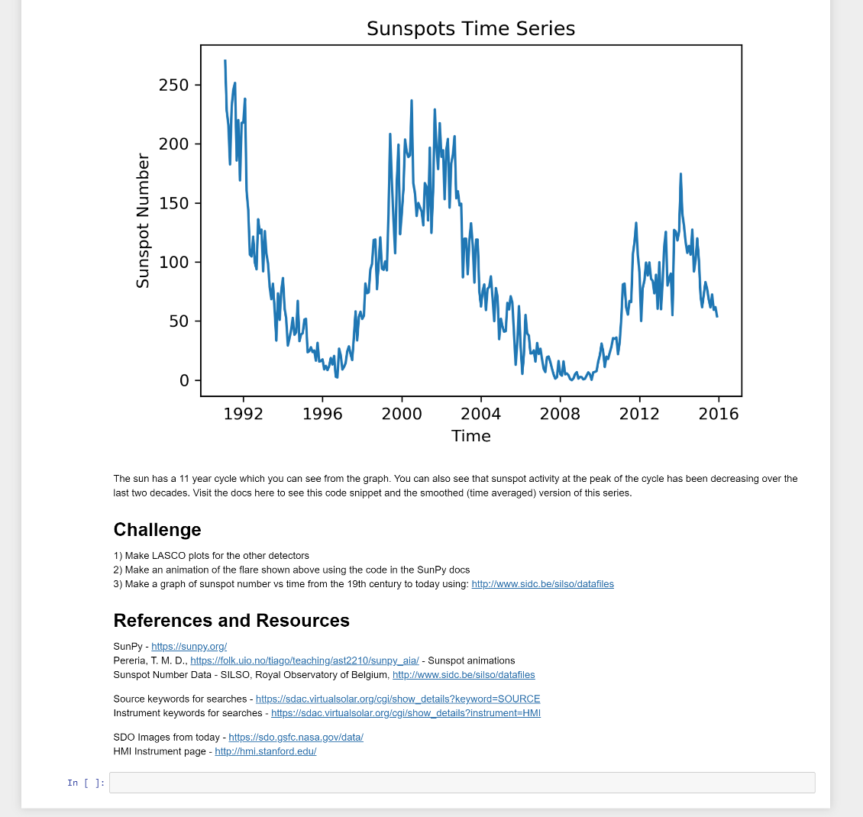
Example Notebook
Final Comments often with suggestions on where to go next for more info
Challenge activity suggestions
Could be used as an assessment
Easy to hard
References and Resources

Slide 8
Improvements
Add space for students to write answers (make sure Q’s have numbers)
Place for student name and class
Add contents at the top to make navigation easier
Add inline images using HTML where possible
Difficulty rating for activities?
PLAN:
Example live notebook
How to upload the files I sent to jupyter.org/try
Breakout rooms so you can try one of the activities I sent via email
Final 5-10 mins back to round up and ask questions

Slide 9
Example LIVE Notebook
https://github.com/astroDimitrios/Astronomy/tree/master/Code/AstPy-6%20Sunspots
AstPy-6 Sunspots
Identification of sunspots in SDO HMI continuum images
Calculation of the sidereal and synodic rotation periods of the sun
Automatic identification and tracking of sunspots using SunPy (challenge)

Slide 10
Where next?
I will continue to make more notebooks!
It would be great if this became a community project!
Be sure to email me if you’re interested in:
Making notebooks
Using/testing notebooks in your classroom
Translating notebooks
Want to chat about astronomy and python!
Notes:
Jimmy Newland and Adam LaMee

Slide 11
Any Questions?
Thanks! Don’t forget to star my GitHub repo and follow me on Twitter and YouTube.
https://forms.gle/hN3429sc4hjvt5iL6
Notes:
https://forms.gle/hN3429sc4hjvt5iL6

